Slide 1
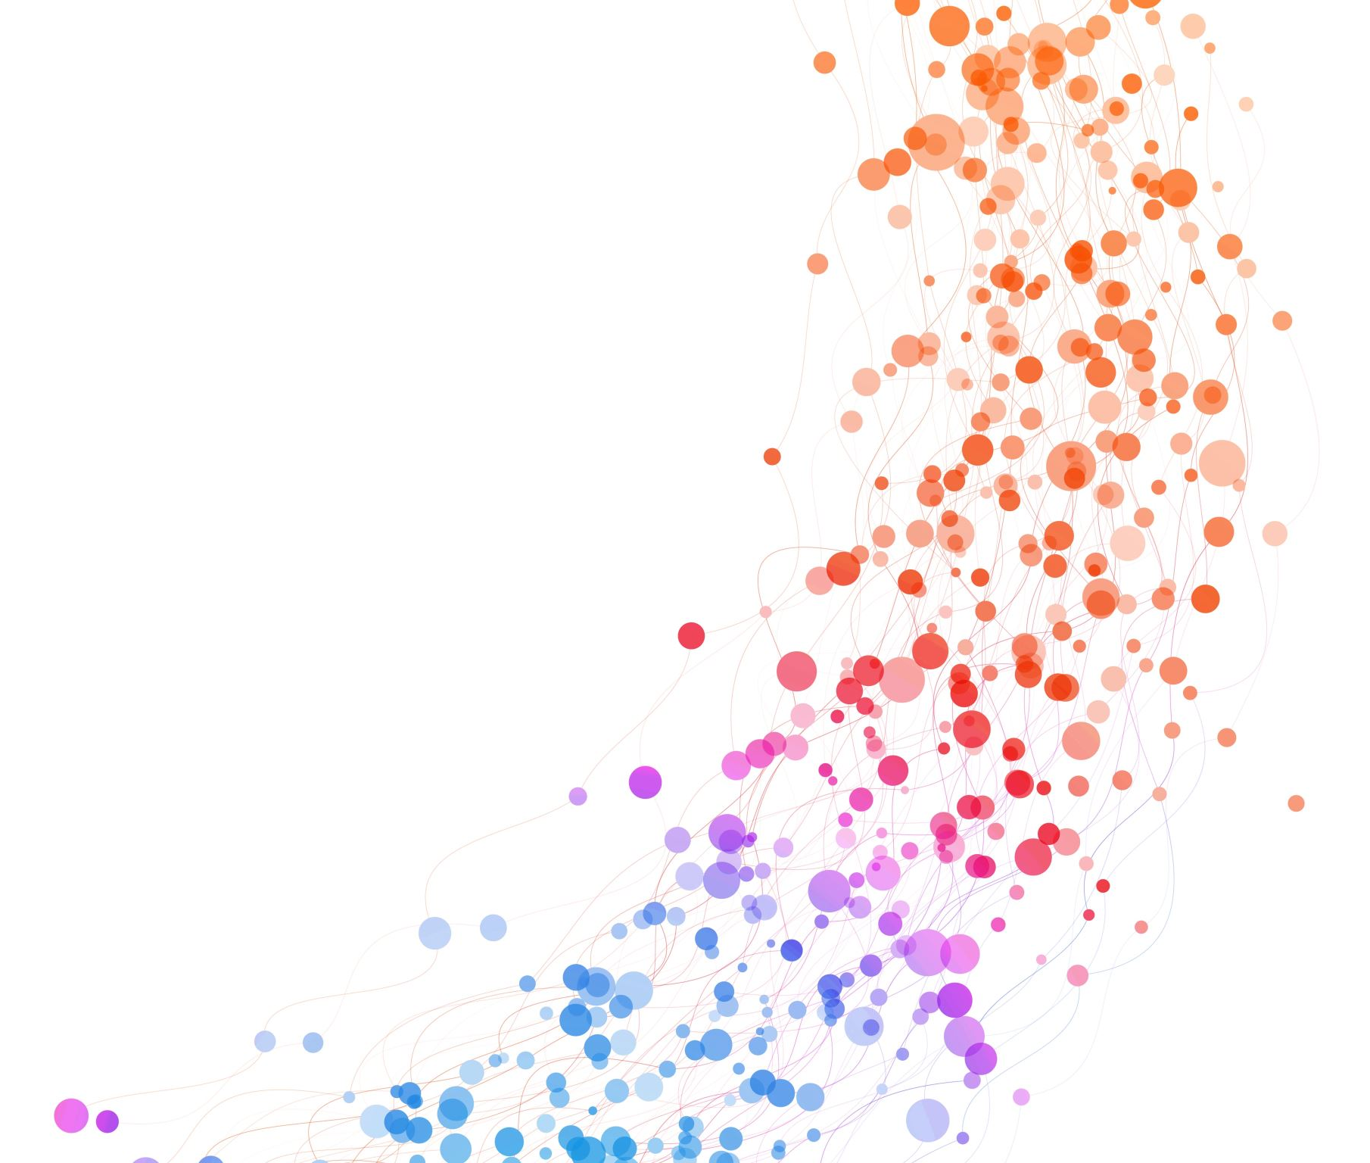
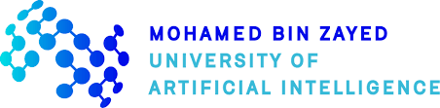
The Applications of Graph Neural Networks
Presenter:
Siwei Liu & Dr Shangsong Liang
Institute:
Mohamed Bin Zayed University of Artificial Intelligence &
University of Glasgow

Slide 2





Background of GNNs
GNNs for Recommendation
Agenda
GNNs for Bioinformatics
GNNs for Particle Physics
Conclusions

Slide 3
Background of GNNs
GNNs for Recommendation
Agenda
GNNs for Bioinformatics
GNNs for Particle Physics
Conclusions

Slide 4
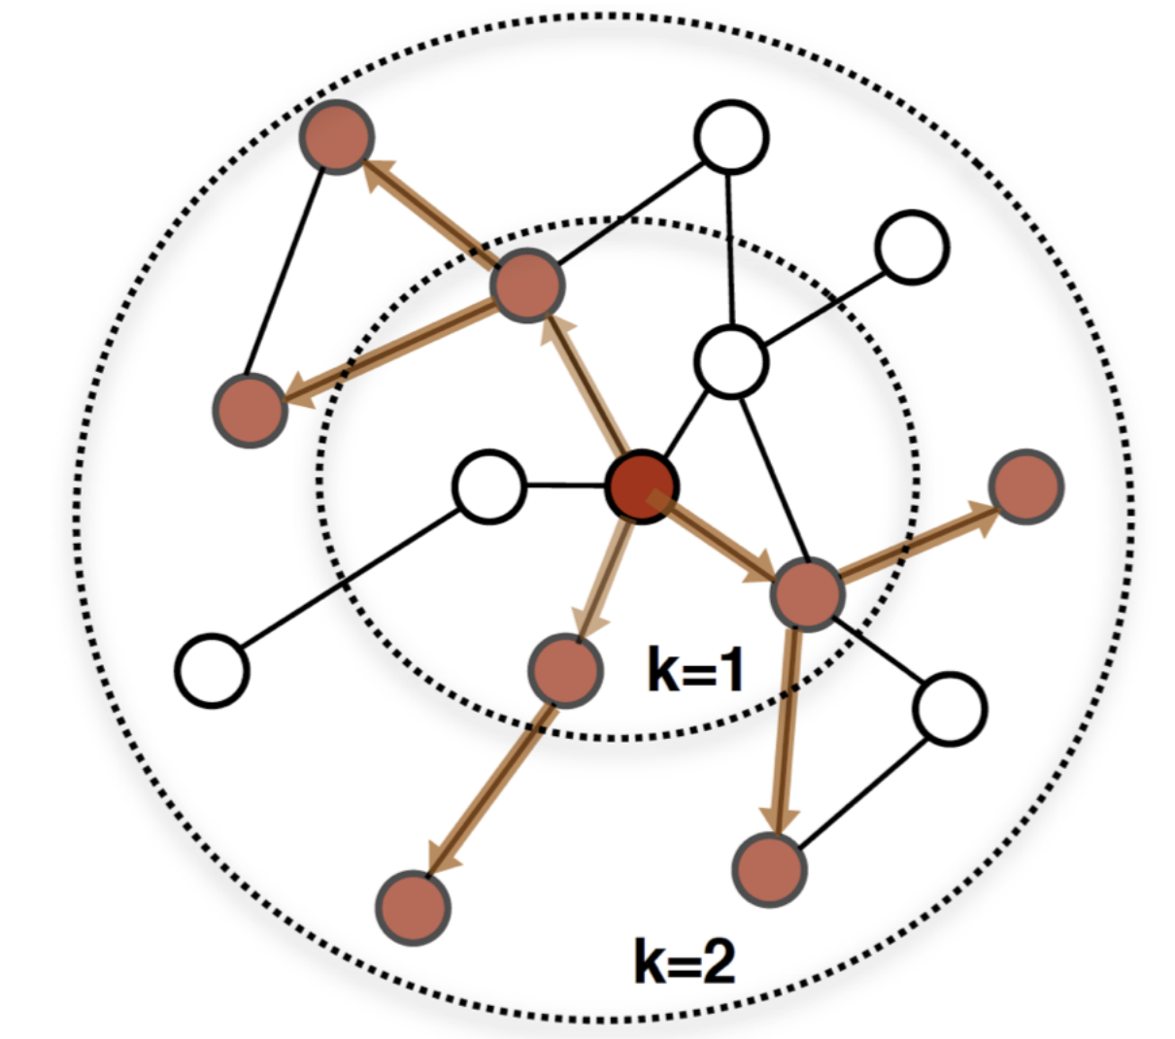
Background
What is Graph:
node
G = ( V, E )
V is a set of nodes
E is a set of edges/links/relations
Edges can be directed or undirected
Nodes can have features
e.g., node types, attributes
Edges can have features
e.g., edge types, edge weights
edge

Slide 5
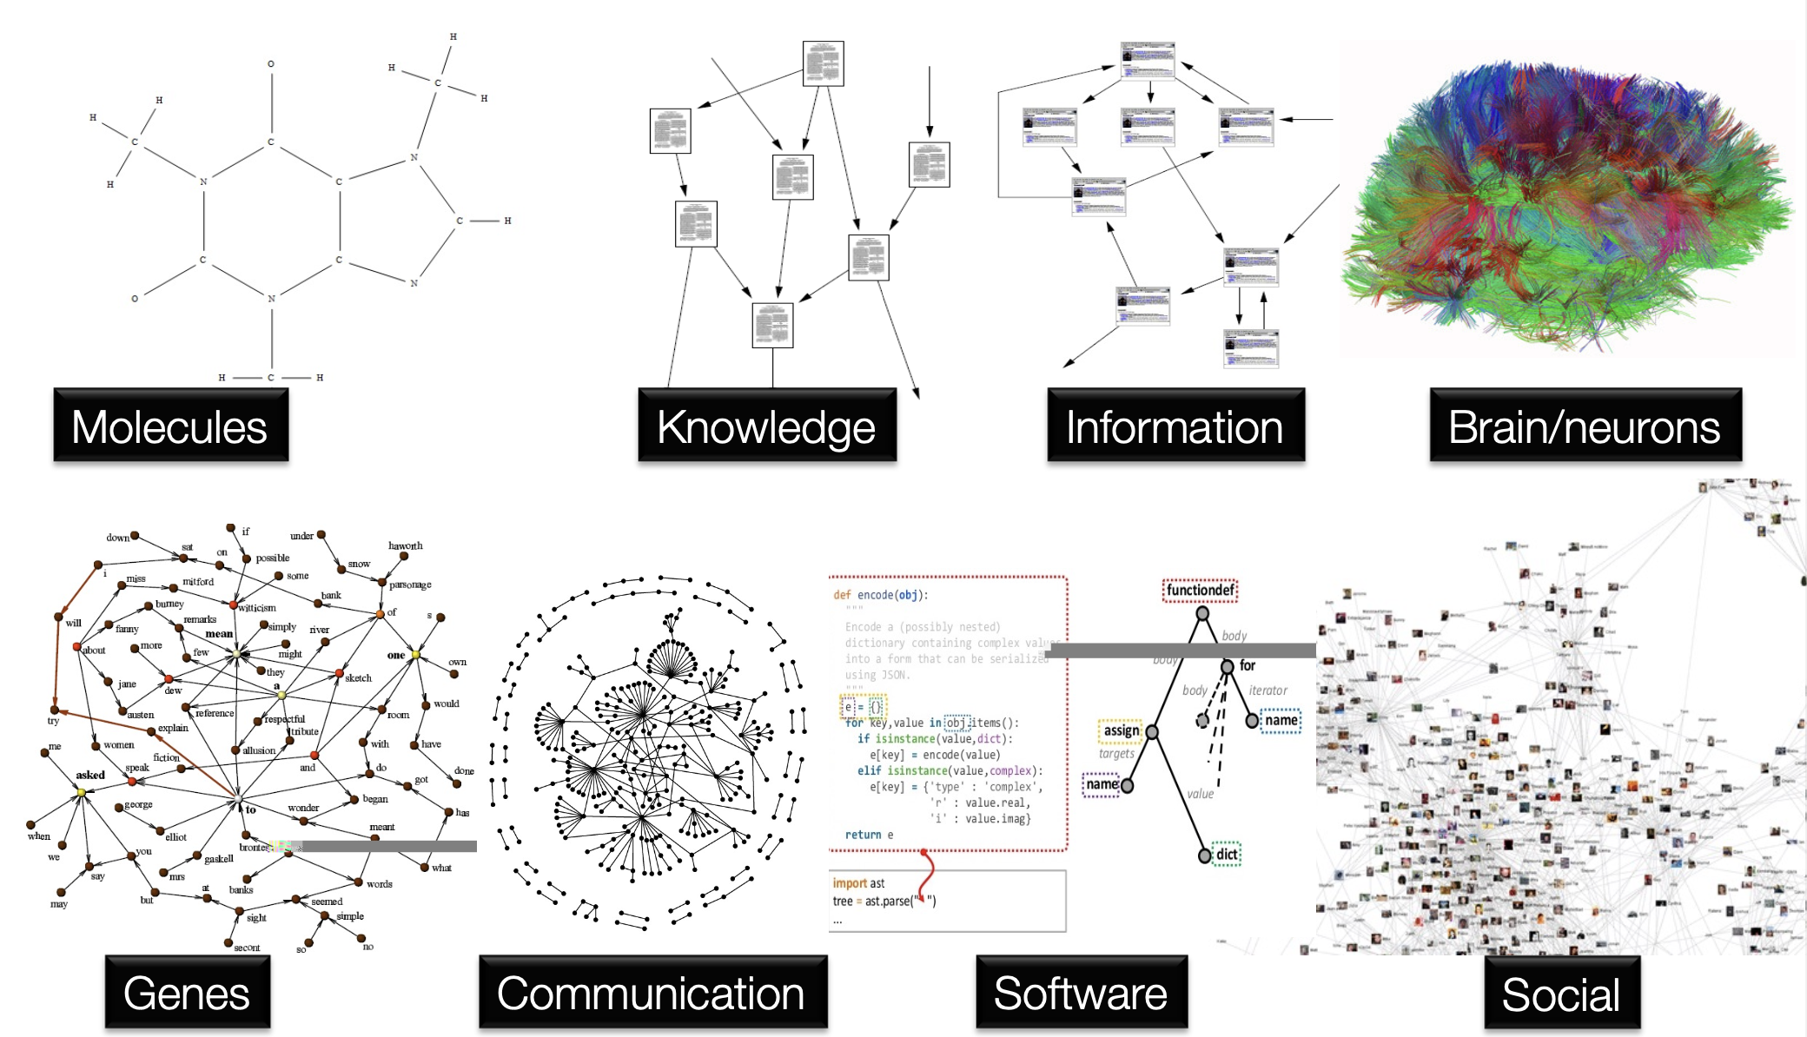
Background
Graphs around us:

Slide 6
Background
Graph-related Task:
Graph-level prediction
- to predict the property of an entire graph
e.g. (molecule as graph) predict whether it will bind to a receptor implicated in a disease
Node-level prediction
- to predict the property of each node within a graph
e.g. node classification, community detection
3. Edge-level prediction
- to predict the property or existence of each edge within a graph
e.g. link prediction
Notes:
In a graph-level task, our goal is to predict the property of an entire graph. For example, for a molecule represented as a graph, we might want to predict what the molecule smells like, or whether it will bind to a receptor implicated in a disease.

Slide 7
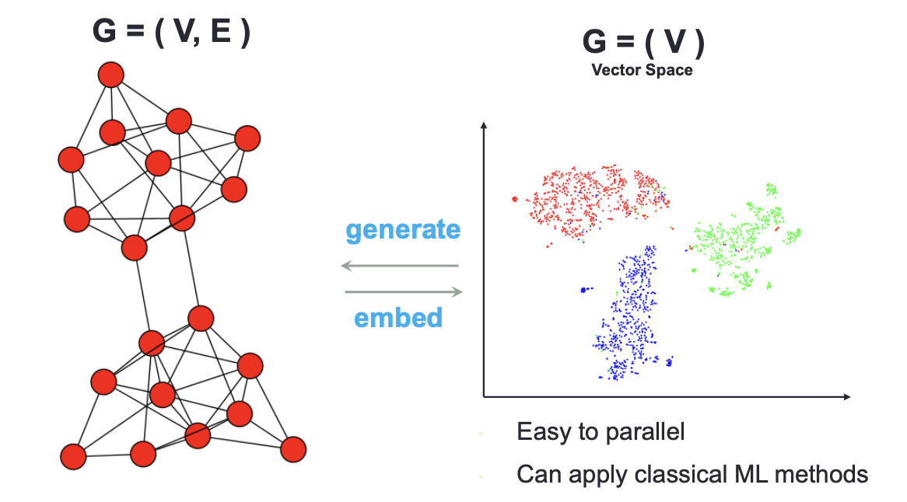
Background
Graph Neural Network (GNN):
Graph Neural Network is a function of neural networks that encodes nodes/edges such that the properties of nodes/edges/graphs contained in the original graph(s) are preserved in the embedding space.
Example:
Original graph (left)
Embedding space (right)

Slide 8
Background
Key advantages of GNN:
Compared with Convolutional Neutral Network (CNN) etc, GNNs can better represent data in the non-Euclidean space.
GNNs can effectively learn the information conveyed by each node’s neighbourhood.
Well-known models:
Graph Convolutional Network (ICLR, 2017).
Graph Attention Network (ICLR, 2018).
Deep neural networks

Slide 9
Background of GNNs
GNNs for Recommendation
Agenda
GNNs for Bioinformatics
GNNs for Particle Physics
Conclusions

Slide 10


GNNs for Recommendation
Recommender systems
Task: Recommend items of interest to users.
Input(s): Incomplete user-item interaction matrix and some side information e.g., timestamps, textual reviews and social relations.
Output(s): Predicted user-item interaction matrix.
User feedback:
Positive feedback (click/view/purchase)
Negative feedback (dislike/return)

Slide 11
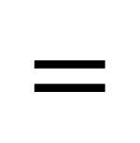


GNNs for Recommendation
Recommender systems
Classical algorithms: Matrix Factorisation, Bayesian Personalised Ranking, User/Item KNN.
Core idea behind recommendation: Decompose the user-item matrix into two latent matrices that represent users’ preferences and items’ characteristics.
Input:
incomplete matrix
Output:
completed matrix
i₁
i₂
i₃
i₄
i₁
i₂
i₃
i₄
u₁
3.1 | 1.9 | 2.7 | 2.5
2.7 | 1.5 | 2.2 | 2.0
3.6 | 2.2 | 3.0 | 2.9
4.3 | 2.9 | 3.8 | 3.8
1.2 | 0.9
1.5 | 0.4
1.4 | 1.0
1.0 | 1.8
$$=$$
u₁
? | 2 | 2.5 | ?
3 | ? | 2.5 | 2
3.5 | 2 | 3 | 3
? | 3 | 4 | ?
$$≈$$
$$×$$
1.4 | 0.7 | 1.1 | 0.9
1.6 | 1.2 | 1.5 | 1.6
u₂
u₂
u₃
u₃
u₄
u₄

Slide 12
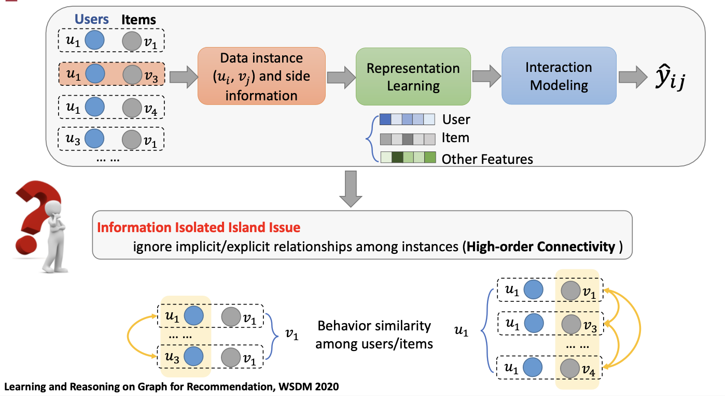
GNNs for Recommendation
Motivations of using GNNs for recommendation:
GNN can help recommender systems to:
Explore various relations between users and items.
Automatically aggregate information from multi-hop neighbours of users and items.

Slide 13
GNNs for Recommendation
Graph Neural Pre-training for Recommendation
Background: Deep learning-based models are usually instable.
Research aims: Build a graph pre-training network containing users, items and side information such that it is more effective and stable.
Proposed Model: Single/Multi Relational Graph Pre-training, accepted by TOIS (A*)
Relational graph construction.
Relational Graph Pre-training.
Fine-tuning of recommendation.

Slide 14
GNNs for Recommendation

Slide 15
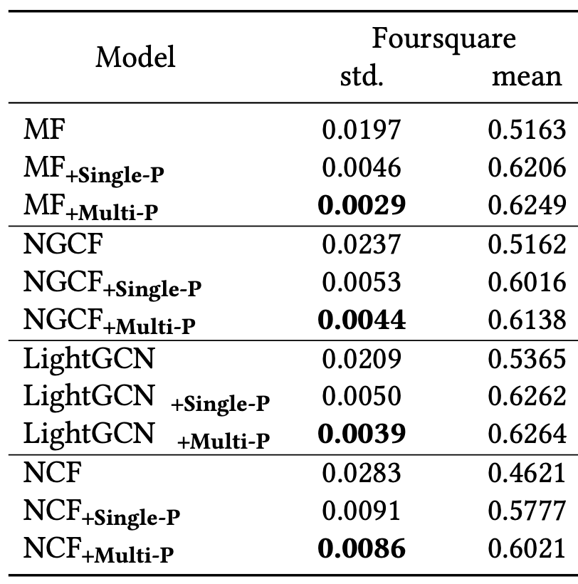
GNNs for Recommendation
Results:
Graph Pre-training can generally improve fine-tuned recommender systems.
Pre-trained models are more stable.

Slide 16
Background of GNNs
GNNs for Recommendation
Agenda
GNNs for Bioinformatics
GNNs for Particle Physics
Conclusions

Slide 17
GNNs for Bioinformatics
Possible nodes:
Gene/DNA.
Disease.
Atom.
mRNA.
Corresponding biomedical graphs:
Molecular graph.
Protein-Protein interaction graph.
Gene-disease interaction graph.
mRNA-disease graph.
Drug-disease graph etc
Graph-based bio data:
Challenging biomedical tasks:
Predict the properties of molecules.
Predict the possible associations between genes and diseases.
Predict the possible associations between mRNAs and diseases.
Predict the possible associations between proteins.

Slide 18
GNNs for Bioinformatics
Metapath GNN for lncRNA–disease association prediction
Collaboration: MBZUAI & University of Glasgow etc.
Research aim:
By automatically identifying the lncRNA–disease associations from existing verified associations to alleviate the labor-intensive issue.
Method:
Use our proposed pathwayLDA model to learn the metapath among miRNA, lncRNA and disease.

Slide 19
GNNs for Bioinformatics
Metapath GNN for lncRNA–disease association prediction

Slide 20
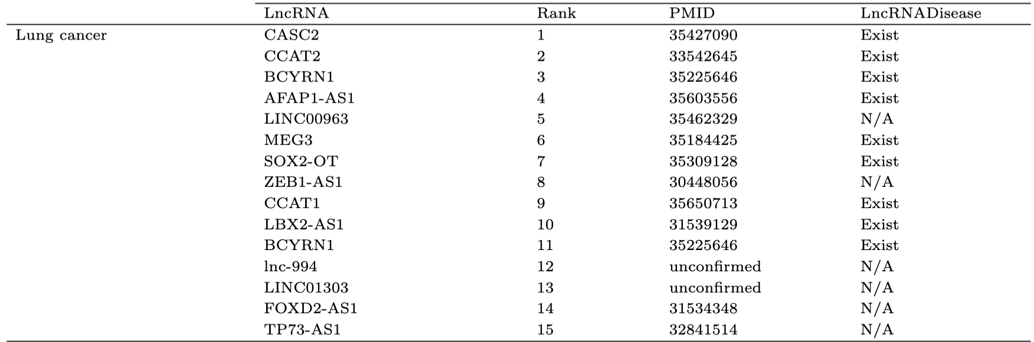
GNNs for Bioinformatics
Metapath GNN for lncRNA–disease association prediction

Slide 21
Background of GNNs
GNNs for Recommendation
Agenda
GNNs for Bioinformatics
GNNs for Particle Physics
Conclusions

Slide 22
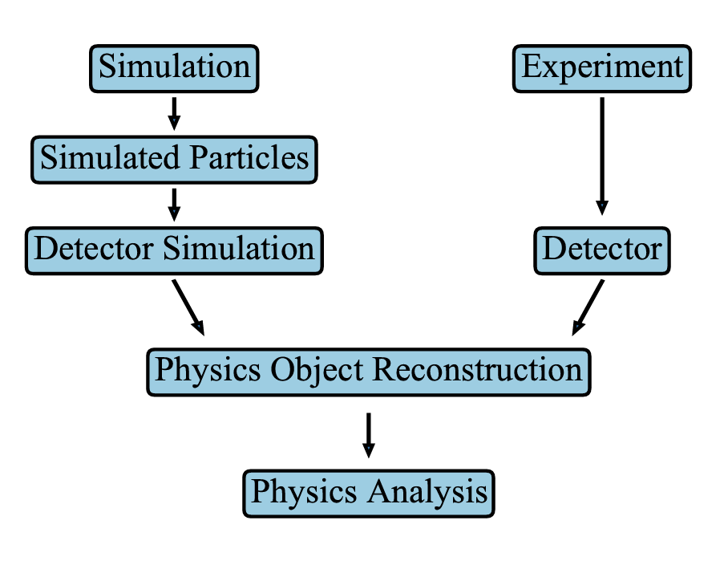
GNNs for Particle Physics
What is particle physics?
Particle physics is a branch of science aiming at discovering the fundamental laws of matter and forces, where matters include quarks and leptons; forces include the strong, weak and electromagnetic forces.

Slide 23
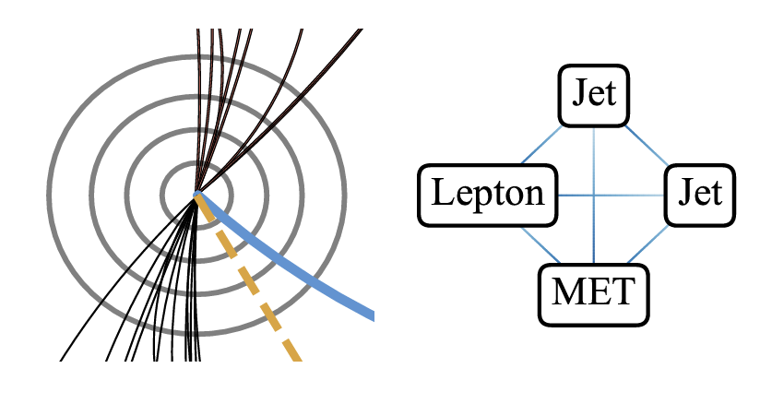
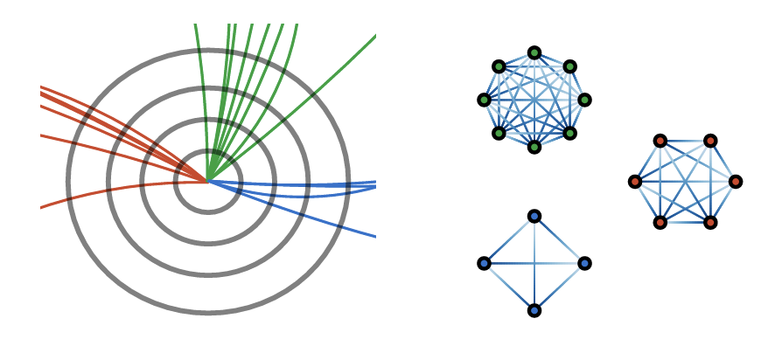
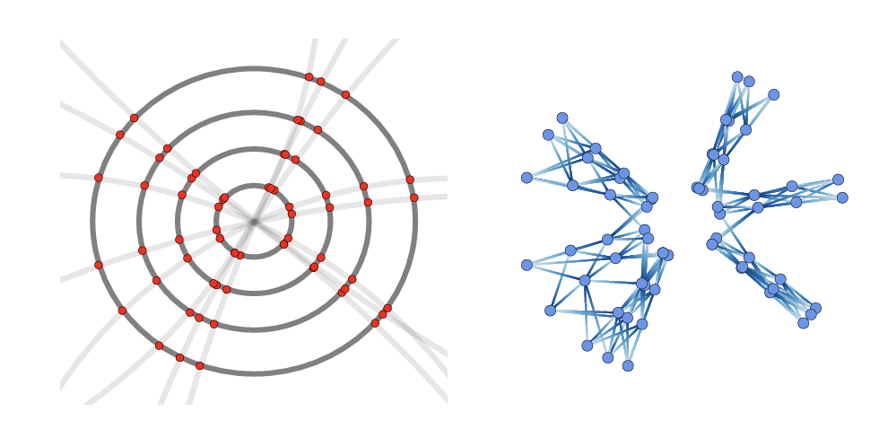
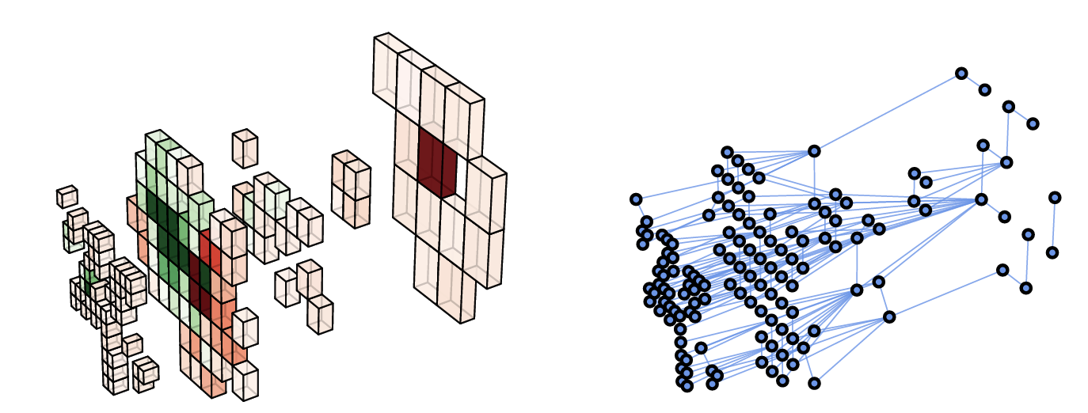
GNNs for Particle Physics
Possible applications of GNNs for particle physics:

Slide 24
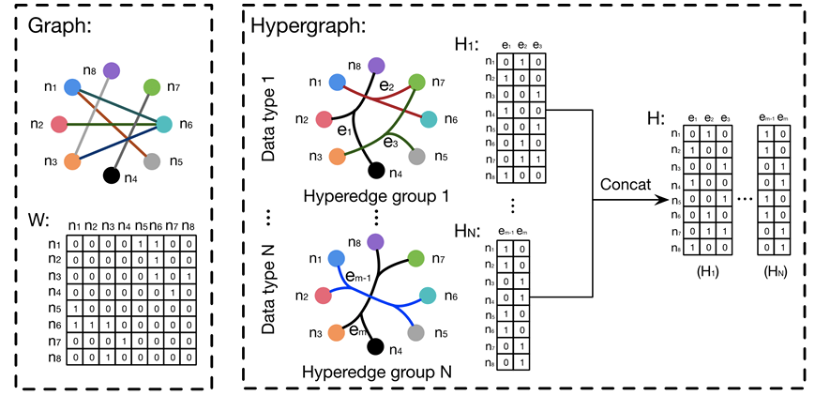
GNNs for Particle Physics
Enhanced hypergraph neural network for particle reconstruction
Collaboration: MBZUAI & University of Glasgow and Weizmann Institute of Science.
Difference:
In normal graphs, one edge can only connect two nodes. While in hypergraph, one hyperedge can connect multiple nodes.
Motivation:
In the collimated environment, one matter may go through multiple layers of the detectors.

Slide 25
Background of GNNs
GNNs for Recommendation
Agenda
GNNs for Bioinformatics
GNNs for Particle Physics
Conclusions

Slide 26
Conclusions
Graph data is ubiquitous and the world is more connected than you think.
Graph is a convenient data structure that can be used to represent the relational network among e-commerce (user-item), biomedical (gene, disease, mRNA, drug) and physical (matter-cell) data.
We can design effective Graph Neural Networks to represent the complex relations between nodes within graphs such that we can use GNNs to predict unseen relations, properties of graphs and properties of edges/nodes.

Slide 27
Acknowledgements & References
Some slides from Dr Zaiqiao Meng (University of Glasgow)
Some slides from Dr Shangsong Liang (MBZUAI)
Kipf, T. N. & Welling, M. Semi-supervised classification with graph convolutional networks. ICLR 2017
Liu, S., Ounis, I., Macdonald, C. & Meng, Z. A Heterogeneous Graph Neural Model for Cold-start Recommendation. SIGIR2020.
Liu S, Meng Z, Macdonald C, Ounis I. Graph neural pre-training for recommendation with side information. ACM Transactions on Information Systems. 2022 Oct 4.
Velickovic, P. et al. Graph attention networks. ICLR 2018.
Feng Y, You H, Zhang Z, Ji R, Gao Y. Hypergraph neural networks. In Proceedings of the AAAI 2019.
Shlomi J, Battaglia P, Vlimant JR. Graph neural networks in particle physics. Machine Learning: Science and Technology. 2020 Dec 29;2(2):021001.
Zhang XM, Liang L, Liu L, Tang MJ. Graph neural networks and their current applications in bioinformatics. Frontiers in genetics. 2021;12.

Slide 28

Contact details:
Email: siwei.liu@mbzuai.ac.ae
Twitter: TedSiwei

